Slide 1

Alternative World
Web Site for Theme Park Proposal

Slide 2









Proposal
Outline
Theme Park
Site Map
Purpose
Wireframes
Target
Audience
Team Work
Reasons
Market
Analysis

Slide 3

Purpose of a website
To generate an online presence
The website will advertise the theme park’s attractions and generate interest from audiences around the globe
Provide customer convenience
Target audiences can easily gather information about the theme park including buying tickets and seasons passes online
To enhance ticket and merchandise sales
Purchasing tickets online allow the theme park to generate income without any personnel involved. The attractions and toy shops generate increased interest for target audiences

Slide 4
What audiences look for in a website
Information about the rides and attractions
Audiences gather information about the attractions that cater to their tastes. Presenting the rides and attractions in the main page can easily generate interest.
Special events and promotions
Audiences look for special theme park events and promotions. Seasonal events such as Christmas/Holiday theme is always popular. Ticket or season’s pass promotions promote interest to potential customers.
Ability to purchase tickets online
Online purchase/e-cart is a necessary website component. This provides convenience to customers wanting to avoid line ups.
Ease of use
A poorly structured website without proper layout of information can drive any potential customer away.
Customer Service
Customer service is integral to potential customers visiting a website for information. By providing a contact us page, a visitor can easily reach out for additional inquiries.

Slide 5
List of theme parks reviewed
The theme parks reviewed for our market analysis are
Ferrari World (https://www.ferrariworldabudhabi.com)
Ferrari World Abu Dhabi is a mostly indoors amusement park on Yas Island in Abu Dhabi, United Arab Emirates. It is the first Ferrari-branded theme park and has the record for the largest space frame structure ever built. The world's fastest roller coaster, is also located here
Warner Bros. World (https://www.wbworldabudhabi.com)
Warner Bros. World Abu Dhabi is an indoor amusement park in Abu Dhabi, United Arab Emirates. The park features characters from Warner Bros.'s franchises, such as Looney Tunes, DC Comics, Hanna-Barbera, and others.
Disney World (https://disneyworld.disney.go.com/)
Disney World, is an entertainment complex in Bay Lake and Lake Buena Vista, Florida, in the United States. The park comprises four theme parks, two water parks, 27 themed resort hotels, nine non-Disney hotels, several golf courses, a camping resort, and other entertainment venues, including the outdoor shopping center Disney Springs.
Europa-Park (https://www.europapark.de/en)
Europa-Park is the largest theme park in Germany, and the second most popular theme park resort in Europe. The park is home to 13 roller coasters, the oldest being Alpenexpress Enzian, a powered coaster that speeds through a diamond mine, and the newest coaster being the Ba-a-a Express, a small kiddie roller coaster.
LunEur (https://www.luneurpark.it/)
LunEur (complete name Luna Park Permanente di Roma) is the largest amusement park in Rome and the oldest in Italy.

Slide 6
Theme park review – Ferrari World and Warner Bros. World
Ferrari World and Warner Bros appear to have been developed using the same web framework.
Below are the aspects of the two sites that appear to work well in attracting customers. By organizing the navigation links under six main links, these sites provide ease of navigation.
Plan your visit
Links about park hours, location and FAQs
Explore
Links about the park’s attractions, rides, shopping areas and events
Tickets
Links to different types of park admission
Offers
Links to new offers or seasonal promotions
Events
Links to the park’s event calendar
Group Booking
A special for large crowd/party booking.
Language Selection
Provides multi-language support in Arabic and English
Account Creation/Login
For season’s pass holders and members to access members only promotions

Slide 7
Theme park review – Disney World
The Disney World theme park in Orlando provides well organized links for ease of navigation. The graphics and the overall presentation are professionally laid out and all the aspects of the web site are very well considered. Disney world also offers an online shopping page for Disney merchandise and a personal planning experience page, specific to Disney World which attracts visitors.
Below are the aspects of the website that appear to work well in attracting customers.
Parks and Tickets
Links to park hours and purchasing tickets
Places to Stay
Disney World specific service where for booking stays in Disney world hotels
Things to Do
Links for dining, shopping and attraction activities
Help and Rules
Customer service page. Provides information about guest services, disability services, FAQs and contacting support
Cart
E-cart for purchase and checkout
Personal planning experience (My Disney Experience)
Disney World specific web feature that allows visitors to create a profile, photo album and itinerary when visiting the theme park.

Slide 8
Theme park review – Europa Park
The Europa Park website’s most important aspect is its minimalistic design. Navigating the site is easy and with less elements/objects, makes the webpage load faster.
Below are the additional positive aspects observed in the website.
Attractions
Links to all Europa Park’s rides and attractions
Shows and Events
Links to events and calendar including showtimes
Accommodation
Links to Europa Park theme park hotels
Food and Drink
Links to all restaurants and bars in the park
Tickets and Gift Cards
Links to purchase park tickets including groups, school trips and hotel gift cards
Info
Provides information about the park’s location, operating hours and other services such birthday parties and loss report
Language support
Europa Park’s website supports English, German, French, Italian and Dutch languages

Slide 9
Theme park review – LunEur park
The LunEur park has aspects in the page that do not work well in attracting potential customers. The website has poorly implemented features including poor colour theme selection, language support and user experience making it very unattractive and hard to navigate in.
Below are the list of website aspects that do not work well with potential customers:
Overall site design
The site design appears too simple, lacking impactful visual. The site looks like a regular blog-posting website with the entire site’s width limited to about 70% percent of usable page real estate
Language support
The website does not support English navigation completely ignoring English speaking customers that would like to visit Rome’s oldest theme park
Navigation
The navigation links are redundant. The navigation links in the header are also provided in the website body. There is no proper navigation flow that takes a visitor from browsing an attraction to purchasing a ticket
Non-usable links
There is an ice cream and McDonald’s link in the footer of the page that has no definition or purpose

Slide 10
Alternative Worlds Theme Park Attractions
The theme of the park is “alternative worlds”. A place where you can experience the future that you decide. Alternative worlds aims to attract families and adventure seekers in a wide range of age groups.
Future Visions
Five cities to be experienced in virtual and augmented reality
The Soft World
An area dedicated to children. From bouncy castles to ball pits, the entire world is “bump” safe.
The Plaza
For all your convenience needs. The Plaza is the place to relax, find food/snack, buy merchandises and souvenirs, withdraw money, customer service and other special park service such as first aid booth.
The Flying Machine
Futuristic and Fast sky coaster (https://en.wikipedia.org/wiki/Skycoaster)
Theatre of the Future
An interactive theatre made by real living people and hologram
To allow ease of access and use, the website is designed to be responsive and adaptive, developed using HTML5.

Slide 11

Site Map
The site map of the Alternative Worlds Web Site is organised with a total of four pages. The book tickets page can be removed to adhere to the requested standard of a total of three pages.

Slide 12
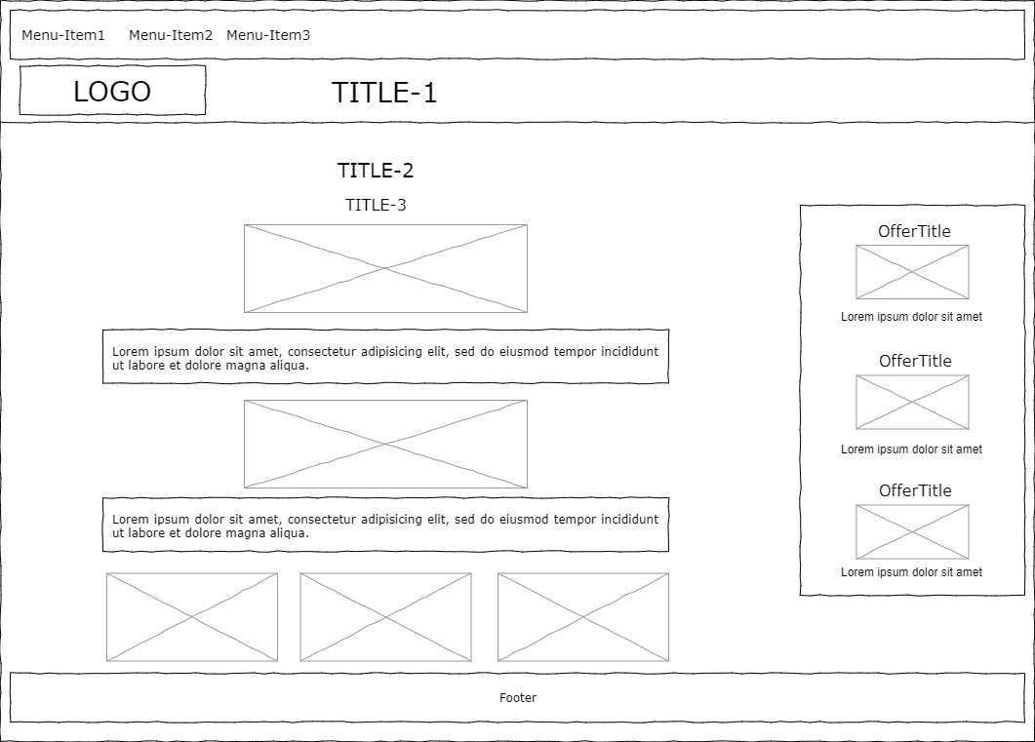
Wireframes – Desktop – Index

Slide 13
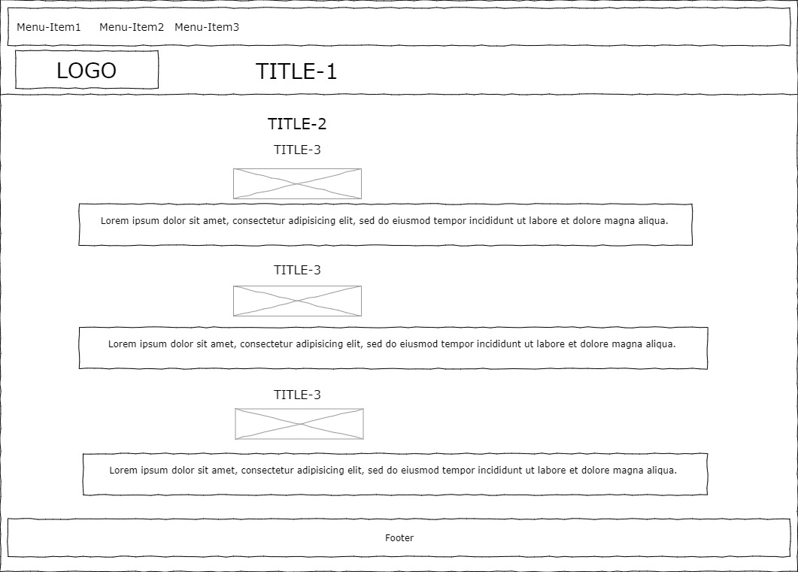
Wireframes – Desktop – Attractions

Slide 14
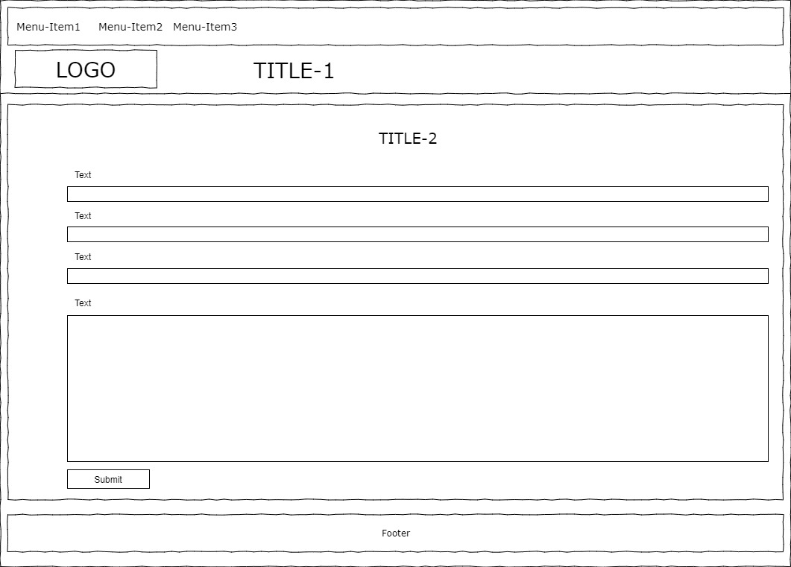
Wireframes – Desktop – Contact Us

Slide 15
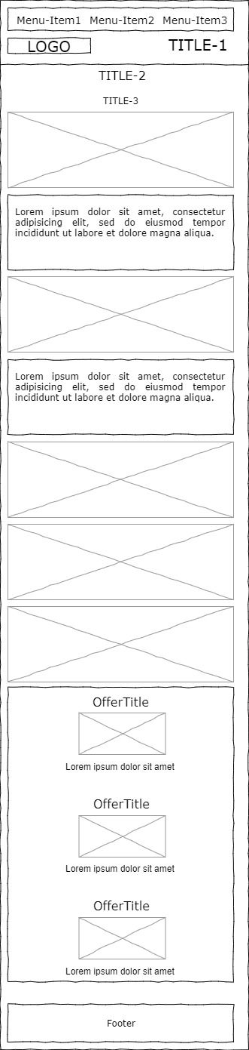
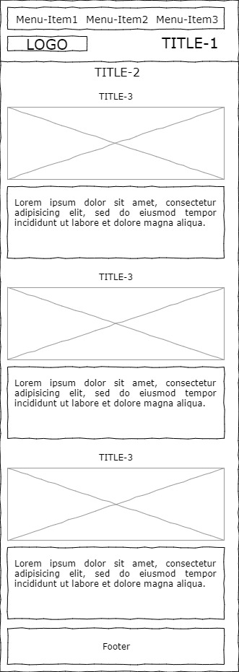
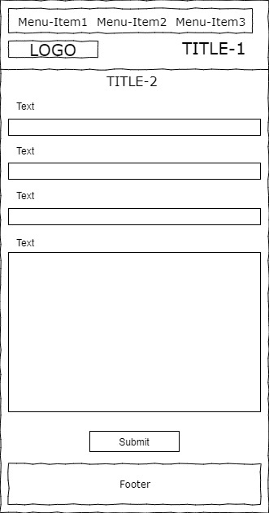
Wireframes – Mobile

